Slide 1

Entering Grade 12​
Parent Information Session
February 2026

Slide 2
Graduation Requirements
Required Courses:
English 10 Foundational
Geometry Measurement & Finance (ENG or FSL)
English 12
Minimum of 25 courses or 100 credit hours
ELPA must be passed; re-writes in gr. 12
English 11 Foundational
Complete the required number of credit hours in each core cluster
Civics (ENG or FSL)
FI students must have 40 credit hours of FI classes in grades 10-12
PIF 10 OR FILA 10 OR Introductory Wolastoqey Latuwewakon 110

Slide 3
Graduation Requirements continued
Language Arts & Languages – 24 credit hours
Humanities – 8 credit hours
Mathematics – 12 credit hours
Science – 8 credit hours
Personal Well-being – 20 credit hours
Plus a min of at least 28 additional credit hours of your choice.
                Total of 100 credit hours

Slide 4

Reminder of Course Levels
Grade
English
11
2
Level
Level "0" courses offered at one level only.
  Ex: Entrepreneurship 110, Law 120, Sociology 120
Level "1" courses enriched university preparatory courses.
  English 111, Physics 111
Level "2" courses academic/university preparatory.
  Ex; English 112, Biology 112,
Level "3" – courses college preparatory/private training institutions such as NBCC, Majestany, Eastern College etc.
  English 113, History 113 etc.

Slide 5
Challenge for Credit – Fast Track
Successful completion of: | Is a “Pass” Credit Equivalent of:
Imagine NB | Personal Interest Course 1 and 2 (E or FI)
Scout Exploration Activity Award | Outdoor Education 110
Duke of Edinburgh Award – Young Canadians Challenge | Outdoor Education 110
Level 4 Cadet Training (in Air, Army, or Sea) | Outdoor Education 110
101/Fundamentals Level Coaching Certification (Competition or Instruction Stream) | Leadership Through Physical Education 120
National Lifesaving Society Certification (NLS) | Leadership Through Physical Education 120
Swim or Lifesaving Instructor Certification | Leadership Through Physical Education 120
Junior Achievement ‘Company Program’ Certificate | Entrepreneurship 110
The immersion program of Université Sainte-Anne | Techniques de communication orale
Girl Guides of Canada Trail Blazer Gold Award | Personal Interest Course 1 OR 2
See page 3 of the course guide for a complete list of fast-track credits.

Slide 6
Special Programs
Co-Op 120 (8 or 12 credit hour options)
  Long Term Care Coop 120 (am only)
  Early Childhood Coop 120
  Horizon Healthcare (am only)
  Army Reserves (pm only)
Personal Interest 1 & 2 (Grade 12)
Lifeguarding Enrichment Program @NMS
Fine Arts Certificate
Dual Credit university courses (in Grade 12)
Courses at FHS (page 9 of guide)
  Framing & Sheathing/Residential Finish (S1) &
  Auto Electrical Systems/Power Train & Chassis (S2)
Applications are available at Guidance and due March 20th

Slide 7
Please note!
High School Graduation Requirements
&
Post-Secondary Admission Requirements
are not the same
Admission Requirements for UNB and STU can be found in our course guide.
Universities have different admission requirements. It is important to look them up and make sure students select the courses they need.

Slide 8
Post Grad (Some Local NB Options)
NBCC Full-Time Programs
Apprenticeship Program
Undergraduate Admission Requirements | UNB
Bachelor of Arts - St Thomas University
Apply Now | Canadian Armed Forces
Gap year resources, programs and events in Canada | CanGap Association
Working NB | PETL Working NB
myBlueprint.ca | Home

Slide 9

Important information!
Grade 11 considering NBCC programs for September 2027 should apply on April 1st of 2026.
Apply on-line, pay application fee, and upload a transcript on April 1st. (order transcript through guidance or online)
Admission is on a first-come, first served basis for all programs.
Take a look at programs now. Delaying application may force students to wait a year before entrance.
NBCC Recruiter Alex Landine will be here on Wednesday, March 18th at lunch in front of the library!

Slide 10
Choosing Courses
Students must choose courses carefully.
Courses chosen by students determine courses offered next year.
If they choose a course, requested changes are not guaranteed.
Course planning sheets are due to their period 2 teacher on March 13^{th.}
March 16th to 20th students need to be in period 2 to submit their course requests in the computer.

Slide 11
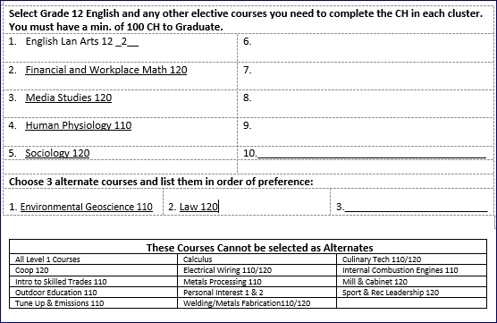
Full or Partial Schedules in grade 12...

Slide 12
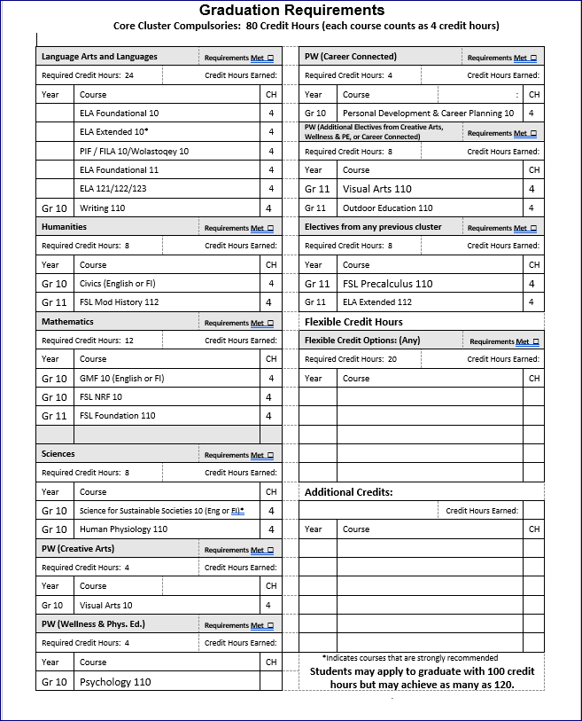
Credit Summary Sheet: Pathway to Graduation

Slide 13
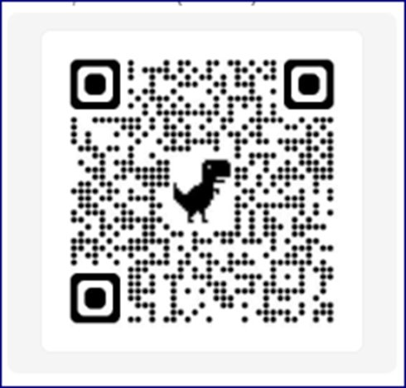
Questions?

