Slide 1

Entering Grade 11​
Parent Information Session
February 2026

Slide 2
Graduation Requirements
Required Courses:
English 10 Foundational
Geometry Measurement & Finance (ENG or FSL)
English 12
Minimum of 25 courses or 100 credit hours
ELPA must be passed; re-writes in gr. 11
English 11 Foundational
Complete the required number of credit hours in each core cluster
Civics (ENG or FSL)
FI students must have 40 credit hours of FI classes in grades 10-12
PIF 10 OR FILA 10 OR Introductory Wolastoqey Latuwewakon 110

Slide 3
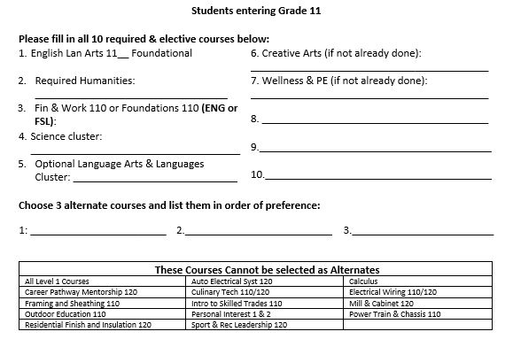
Required Grade 11 Courses

Slide 4
Required Humanities (choose one of…)
Ancient and Medieval History 112
Canadian History 122
FSL Canadian History 122
FSL Modern History 112
Modern History 111, 112 or 113
Wabanaki Studies 120
World Issues 120

Slide 5
Required Science (choose at least one of…)
Auto Electrical Systems 120* | Environmental Science 120
Biology 111 or 112 | FSL Biology 112
Biology 121 or 122 | Human Physiology 110
Chemistry 111 or 112 | Introduction to Electronics 110*
Chemistry 122 or 122 | Physics 111 or 112
Environmental Geoscience 110 | Physics 121 or 122

Slide 6
Language Arts & Languages
English 112/113/111 Foundational English 122/123/121
English 112/113/111 Extended Spanish
Writing 110 Tech de Comme 110
Fila 110 Tech de Comme 120
Fila 120 Graphic Novels 120
Post Intensive French 10/110/120 Media Studies 120

Slide 7
Choose Electives from the Core Clusters
Language Arts & Languages – 24 credit hours
Humanities – 8 credit hours
Mathematics – 12 credit hours
Science – 8 credit hours
Personalized Well-being – 20 credit hours
Creative Arts (minimum of 1)
Wellness and PE (minimum of 1)
Career-Connected (minimum of 1)
Plus a min of at least 28 additional credit hours of your choice.

Slide 8

Course Levels
Grade
English
11
2
Level
Level "0" courses offered at one level only.
Ex: Entrepreneurship 110, Law 120, Sociology 120
Level "1" courses enriched university preparatory courses.
English 111, Physics 111
Level "2" courses academic/university preparatory.
Ex; English 112, Biology 112,
Level "3" – courses college preparatory/private training institutions such as NBCC, Majestany, Eastern College etc.
English 113, History 113 etc.

Slide 9
Challenge for Credit – Fast Track
Successful completion of: | Is a “Pass” Credit Equivalent of:
Imagine NB | Personal Interest Course 1 and 2 (E or FI)
Scout Exploration Activity Award | Outdoor Education 110
Duke of Edinburgh Award – Young Canadians Challenge | Outdoor Education 110
Level 4 Cadet Training (in Air, Army, or Sea) | Outdoor Education 110
101/Fundamentals Level Coaching Certification (Competition or Instruction Stream) | Leadership Through Physical Education 120
National Lifesaving Society Certification (NLS) | Leadership Through Physical Education 120
Swim or Lifesaving Instructor Certification | Leadership Through Physical Education 120
Junior Achievement ‘Company Program’ Certificate | Entrepreneurship 110
The immersion program of Université Sainte-Anne | Techniques de communication orale
Girl Guides of Canada Trail Blazer Gold Award | Personal Interest Course 1 OR 2
See page 3 of the course guide for a complete list of fast-track credits.

Slide 10
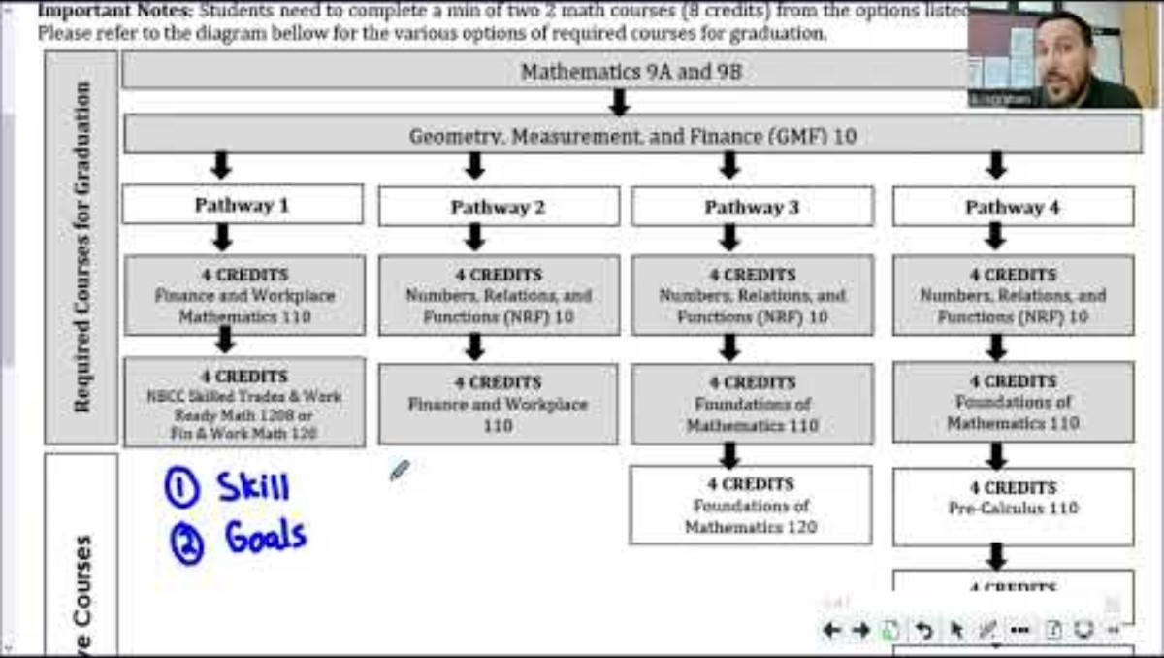
Math Pathways and Post Secondary Plans

Slide 11
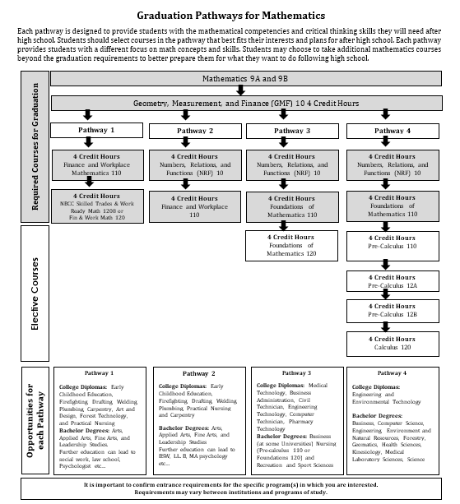
Math Pathways and Post Secondary Plans

Slide 12
Special Programs
Career Pathway Mentorship 120 (8 or 12 credit hour options)
Long Term Care Coop 120 (am only)
Early Childhood Coop 120
Horizon Health Coop (limited)
Reserves Coop
French Immersion Program
Certificate of Immersion - 10 FI courses in grades 10 - 12
Certificate of Proficiency – must be in a grade 12 FI course to be automatically tested
Dual Credit university courses (in Grade 12)
Lifeguarding Enrichment Program @NMS
Technical/Vocational Courses at FHS
Semester 1 – Residential Finish and Insulation 120 and Framing and Sheathing 110
Semester 2 – Automotive Electrical Sysytems 120 and Power Train and Chassis 110
Applications available at Guidance and due March 20th

Slide 13
REMINDER
Graduation Requirements are not the same as Post-Secondary Admission Requirements-
Students must do some research

Slide 14
Choosing Courses
Students must choose courses carefully.
Courses chosen by students determine courses offered next year.
If they choose a course, they will be expected to remain in the course.
We try our best to make sure students get the courses they want but sometimes courses fill up so it is important that they select alternate courses that interest them.
Course planning sheets are due to their Period 2 teacher on March 13^{th.}
March 16th to 20th students need to be in Period 2 to submit their course requests in the computer.

Slide 15
Questions?

