Slide 1

Grad Info & Scholarships
Scholarship Information 2025-2026
LHHS Guidance & Transitions

Slide 2
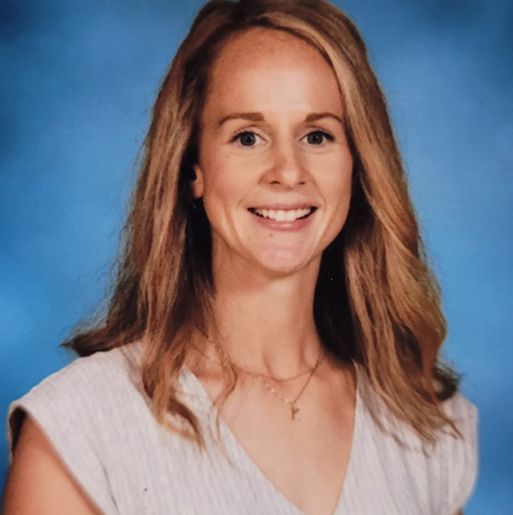


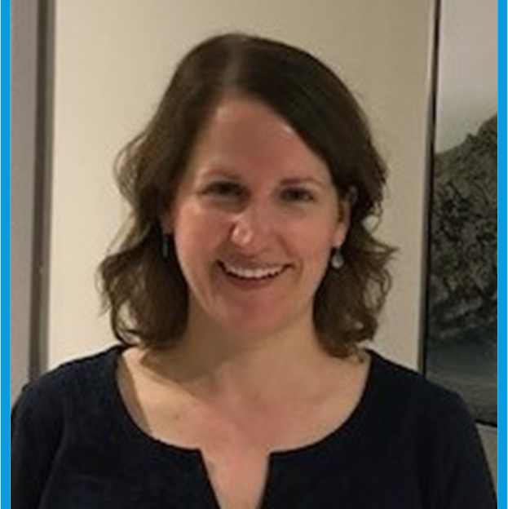
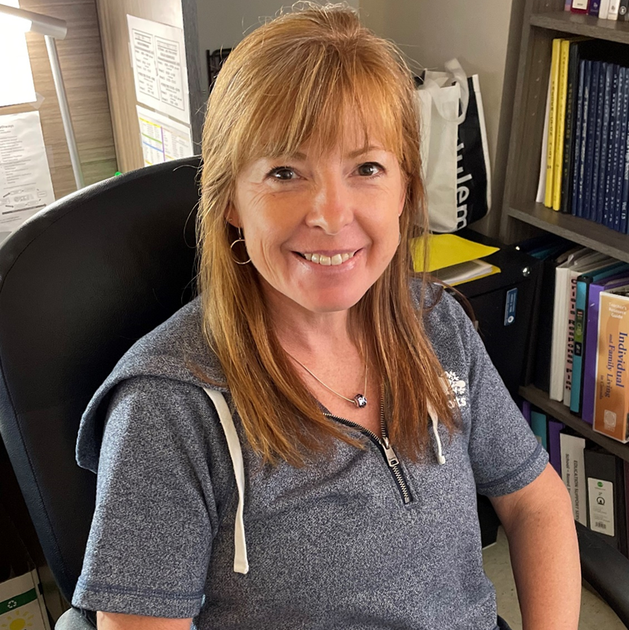
LHHS School Counselling Team
Mrs. Piercy A - CL
Mrs. Hanson Cm - G
Mrs. Pugh H - Mb
Ms. Stinson Mc - Re
Mrs. Gatto Rf - Z

Slide 3
Graduation Requirements
Students are responsible to make sure they have the following compulsory courses for graduation:
:
English 10 Foundational
English 11 Foundational
PIF 10 OR FILA 10 OR Intro to Wolastoqey 10
Geometry Measurement & Finance 10 (ENG or FSL)
Civics (ENG or FSL)
English 12
Complete the required number of credit hours in each core cluster
Min 25 courses of 100 credit hours
ELPA Must be passed
FI students must take 10 courses or 40 credit hours in grades 10-12 to get their FI Certificate.
Some students may have a “Free period”.
Notes:
Before we discuss post secondary options let’s take a look at HS Graduation Requirements. Please put a check mark on your transcript, next to each of the required courses, to make sure you have all the courses you need to graduate. Your HR teacher will be collecting your transcript at the end of the presentation so that you and your Guidance Counsellor can meet to discuss your post-secondary plans and make any necessary changes. You will need to successfully pass; English 11, English 12, Grade 11 math – either Fin and Workplace 11 or Foundations 11, Modern History 11, 1 science course, 1 Fine arts Liferole course – the following slide has a complete list of those courses, as well as 5 courses at the grade 12 level. English 12 would count for one of them.

Slide 4


What Is Next?
Work
Community College
Private/Career College
Military
Volunteer
Travel/Exchange Trips
University
Working NB
Notes:
Before we discuss post secondary options let’s take a look at HS Graduation Requirements. Please put a check mark on your transcript, next to each of the required courses, to make sure you have all the courses you need to graduate. Your HR teacher will be collecting your transcript at the end of the presentation so that you and your Guidance Counsellor can meet to discuss your post-secondary plans and make any necessary changes. You will need to successfully pass; English 11, English 12, Grade 11 math – either Fin and Workplace 11 or Foundations 11, Modern History 11, 1 science course, 1 Fine arts Liferole course – the following slide has a complete list of those courses, as well as 5 courses at the grade 12 level. English 12 would count for one of them.

Slide 5
Admission Information
Students must check to see that they meet the admission requirements and deadlines of universities/colleges of interest.
Early Admission - Students will be assessed based on sem. 1 marks and grade 11 marks for early admission.
Most institutions require a fee to process applications.
For those students interested in residence a separate application is usually required, as is a separate fee. Residence is competitive, apply early.
Notes:
For those of you who are considering University or College after High School, you will need to check the post-secondary school websites in order to ensure you have the courses that are required to get into the program you choose. We have view books in Guidance on most of the Canadian schools and we can help connect you to recruiters who will be happy to answer any questions you might have. Students who apply for early admission will be assessed based on grade 11 marks as well as first semester of grade 12. Most institutions require a fee to process your application. If you plan on staying in residence, a separate application is usually required as is a separate fee. Residence is competitive, so apply early.

Slide 6
Ordering Transcripts
Order ahead of time at the Guidance office, on Teams
https://leohayeshigh.nbed.ca/i/ordering-transcripts/
Please allow a few days for transcripts to be processed.

Slide 7
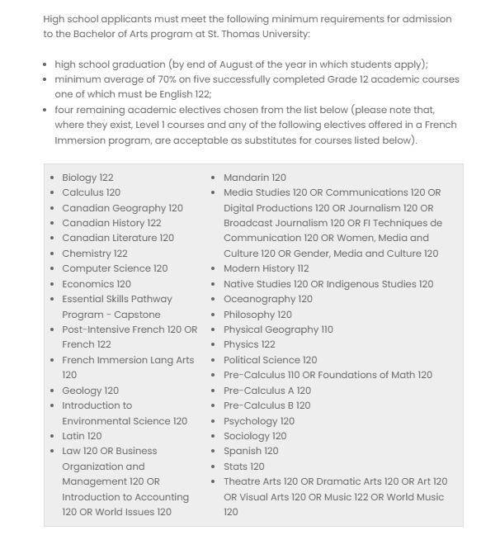
STU Admissions Requirements

Slide 8
University of New Brunswick
UNB Undergraduate Admission Requirements

Slide 9
Application Process
Most are on-line
Application for Atlantic universities and colleges usually begin after semester one
Ontario/BC universities can require earlier admission.
College-NBCC-NOW!
See Ms. Stinson for info
on writing SAT’s for US schools
Notes:
Most applications are done on-line. You will need to check the University or College website to see when their deadlines are. Ontario and BC Universities sometimes have earlier deadlines. Application deadlines for Colleges vary but if you are planning on applying to NBCC- you should do that now! They accept students on a first come first served bases as long as you meet the program requirements. If you don’t apply early you could be placed on a wait list for the following year. It is important to remember that the application is only part of the process. You will also need to ask Kathie, in Guidance, so send a transcript or your marks after each reporting period and especially the final one in June. If you are need information on writing SAT’s for applying to US schools, please see Ms. Stinson in Guidance.

Slide 10
In Person & Virtual events
Tuesday, September 23rd / STU / Recruiter: Cristi Flood / Sign up at Guidance for potential admission on the spot one on one meetings. Meetings will take place in the Dream Catcher Room and application fees will be waived!
Monday, September 29th / UNB / Recruiter: Sarah Craig / Sign up at Guidance for potential admission on the spot one on one meetings. Meetings will take place in the Dream Catcher Room and application fees will be waived!
Friday, November 7th/ University of Alberta / Recruiter: Sophie Hurst / Booth in front of the library over our lunch hour from 12:20pm – 1:20pm!
Tuesday, November 18th / University of King's College (Halifax, NS) / Recruiter: Laura Hillyard / Booth in front of the library over our lunch hour from 12:20pm – 1:20pm!
Monday, November 24th / Acadia University / Recruiter: Cassidy Collins / Booth in front of the library over our lunch hour from 12:20pm – 1:20pm! If you bring your transcript, you may qualify for admission on the spot and have your application fee waived!

Slide 11
Where do I look for scholarship & post secondary information?
Leo Hayes Website
Apply for Scholarships – Anglophone School District West
Teams
LHHS Grade 12
Scholarship information
Post secondary information

Slide 12
Where do I look for scholarship & post secondary information?
LHHS Grade 12 Teams 2025-26

Slide 13

Loranscholar.ca
Info session for students:
Thursday September 18th @ Perido 3 in A179
Students sign up at Guidance
Can start application now!
Due: October 16th

Slide 14
Within Post-secondary Websites
Universities and colleges have internal entrance scholarships and larger scholarships that students should apply for if they meet the criteria
Entrance scholarships may be offered (based on grades)
Example:
UNB Scholarships

Slide 15
We also recommend the following websites to continue your search...
www.studentawards.com (Scholarships & Contests)
www.scholarshipscanada.com (Scholarships & Contests)
www.scholartree.ca (Create a profile, find scholarships that match your strengths/needs)
www.studentaid.gnb.ca (Student loan info)

Slide 16
Tips
Essay:
General essay:
about yourself, your character, resilience, service to others, etc.
outline why you deserve a scholarship
include leadership roles/activities
highlight what you’ve learned
how your experiences have helped shape you
Ask an English teacher or Guidance Counsellor for support at any point in the essay-writing process
can generally use the same essay, tweaking parts to make it fit that specific scholarship
*Sometimes, essays are answering question(s) in an essay format (be sure to follow the essay guidelines carefully for each scholarship)
Once essay is written have it proofread and edited by: Teacher/Parent/Guidance

Slide 17
Tips continued…
Reference Letter(s):
Give the person 2+ weeks notice
Provide the name of scholarship
Let them know the due date of the scholarship (or when you plan to submit your application)
People to ask: coaches, teachers, work managers/supervisors
Provide a “Brag Sheet”, outlining all volunteer, sports, extra-curricular, leadership involvement (pick up a helpful sheet at Guidance ☺)
names of organizations, your role, dates
Follow the specific scholarship outline/requirements!

