Slide 1

Entering Grade 10​
Parent Information Session
February 2025

Slide 2

Required Courses and Credits
In grade 10, students will begin earning credit hours toward graduation requirements.
Each course passed counts as 4 credit hours.
In grade 10, 11 and 12 students can earn up to 120 credit hours (10 courses/year = 40 credit hours).
Students must earn a min of 100 credit hours to graduate.
Most of their grade 10 courses are required but there is some choice.

Slide 3

Students entering grade 10 must take the following courses:
English Language Arts 10 Foundational 10
**English Language Arts 10 Extended 10 Geometry, Measurement & Finance (GMF) 10 (ENG or FSL)
Civics (ENG or FSL) **Science for Sustainable Societies 10 (ENG or FSL)
Post Intensive French 10 OR FI Language Arts 10 OR Wolastoqey 10 ** Strongly recommended

Slide 4
Students will choose 4 more classes from the following clusters
Core clusters:​
Language Arts & Languages
24 CH
Humanities
8 CH
Mathematics
12 CH
Sciences
8 CH
Personalized Well Being
20 CH

Slide 5
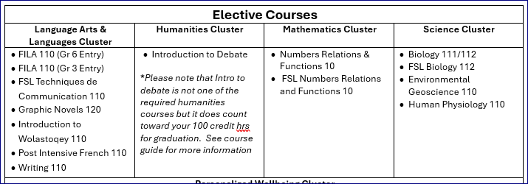
Elective Course Options

Slide 6
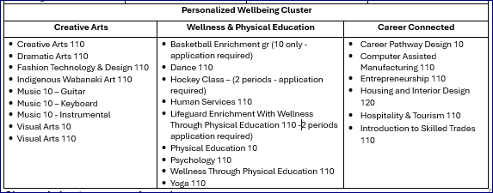
Elective Course Options Continued…

Slide 7
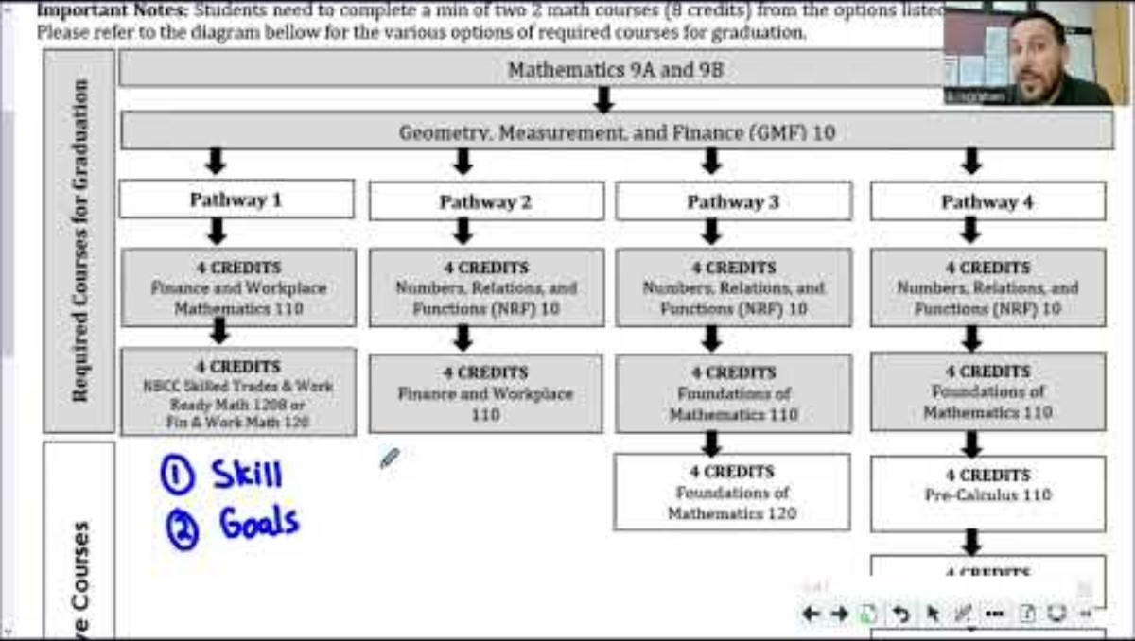

Slide 9
Choosing Your Four Electives
Choose electives carefully
Consider completing core cluster options ie Creative Arts or Physical Education and Wellness
Courses chosen by students determine courses offered next year.
If you choose a course, you will be expected to remain in the course.
Some Courses you may want to take in grades 11 and 12 required prerequisites that you may want to take next year.
Take Courses that interest you!

Slide 10
Challenge for Credit – Fast Track
Successful completion of: | Is a “Pass” Credit Equivalent of:
Imagine NB | Personal Interest Course 1 and 2 (E or FI)
Scout Exploration Activity Award | Outdoor Education 110
Duke of Edinburgh Award – Young Canadians Challenge | Outdoor Education 110
Level 4 Cadet Training (in Air, Army, or Sea) | Outdoor Education 110
101/Fundamentals Level Coaching Certification (Competition or Instruction Stream) | Leadership Through Physical Education 120
National Lifesaving Society Certification (NLS) | Leadership Through Physical Education 120
Swim or Lifesaving Instructor Certification | Leadership Through Physical Education 120
Junior Achievement ‘Company Program’ Certificate | Entrepreneurship 110
The immersion program of Université Sainte-Anne | Techniques de communication orale
Girl Guides of Canada Trail Blazer Gold Award | Personal Interest Course 1 OR 2
See page 3 of the course guide for a complete list of fast-track credits.

Slide 11
Enter Two Alternate Courses
Students must carefully consider and choose 2 additional courses that they would take if any of their chosen courses cannot be scheduled.
- Students cannot select Basketball Enrichment, Biology 111, Hockey Class, Lifeguard Enrichment, Numbers, Relations & Functions 10 or Intro to Skilled Trades as alternate courses.

Slide 12
Course Selection Process
Talk
We encourage students to talk to their parents/teachers to help guide their decisions
Make
Make sure they select choices carefully. They will not have the opportunity to change their mind in the fall, unless it affects post secondary plans
Pass in
Pass in their completed Course selection form to their Advisory teacher by March14th.
Be
Be in Advisory March 17th to 21st to enter their choices in the computer – if they are late, they may not get the courses you want

Slide 13
Questions?

