Slide 1
Entering Grade 11​
Parent Information Session
February 2025

Slide 2
Graduation Requirements
Required Courses:
English 10 Foundational
Geometry Measurement & Finance (ENG or FSL)
English 12
Minimum of 25 courses or 100 credit hours
ELPA must be passed; re-writes in gr. 11
English 11 Foundational
Complete the required number of credit hours in each core cluster
Civics (ENG or FSL)
FI students must have 40 credit hours of FI classes in grades 10-12
PIF 10 OR FILA 10 OR Wolastoqey 10

Slide 3
Choose Electives from the Core Clusters
Language Arts & Languages – 24 credit hours
Humanities – 8 credit hours
Mathematics – 12 credit hours
Science – 8 credit hours
Personal Well-being – 20 credit hours
Plus a min of at least 28 additional credit hours of your choice.

Slide 4
Required Grade 11 Courses
English Language Arts 11 – Foundational
One of the following Humanities Courses:
Ancient & Medieval History 112
Canadian History 112 (ENG or FSL)
Modern History 11 (ENG or FSL)
Wabanaki Studies 120
World Issues 120
One of the Following Math Courses:
Finance & Workplace Math 110
Foundations 110 (ENG or FSL)

Slide 5
Choosing Electives
Choose electives carefully
Consider completing core cluster options to allow for more flexibility in grade 12.
Courses chosen by students determine courses offered next year.
If you choose a course, you will be expected to remain in the course.
Some Courses have prerequisites – read course descriptions carefully!
Take Courses that interest you!

Slide 6
Course Levels
Grade
English
11
2
Level
Level "0" courses offered at one level only.
Ex: Entrepreneurship 110, Law 120, Sociology 120
Level "1" courses enriched university preparatory courses.
English 111, Physics 111
Level "2" courses academic/university preparatory.
Ex; English 112, Biology 112,
Level "3" – courses college preparatory/private training institutions such as NBCC, Majestany, Eastern College etc.
English 113, History 113 etc.

Slide 7
Challenge for Credit – Fast Track
Successful completion of: | Is a “Pass” Credit Equivalent of:
Imagine NB | Personal Interest Course 1 and 2 (E or FI)
Scout Exploration Activity Award | Outdoor Education 110
Duke of Edinburgh Award – Young Canadians Challenge | Outdoor Education 110
Level 4 Cadet Training (in Air, Army, or Sea) | Outdoor Education 110
101/Fundamentals Level Coaching Certification (Competition or Instruction Stream) | Leadership Through Physical Education 120
National Lifesaving Society Certification (NLS) | Leadership Through Physical Education 120
Swim or Lifesaving Instructor Certification | Leadership Through Physical Education 120
Junior Achievement ‘Company Program’ Certificate | Entrepreneurship 110
The immersion program of Université Sainte-Anne | Techniques de communication orale
Girl Guides of Canada Trail Blazer Gold Award | Personal Interest Course 1 OR 2
See page 3 of the course guide for a complete list of fast-track credits.

Slide 8
Math Pathways and Post Secondary Plans

Slide 9
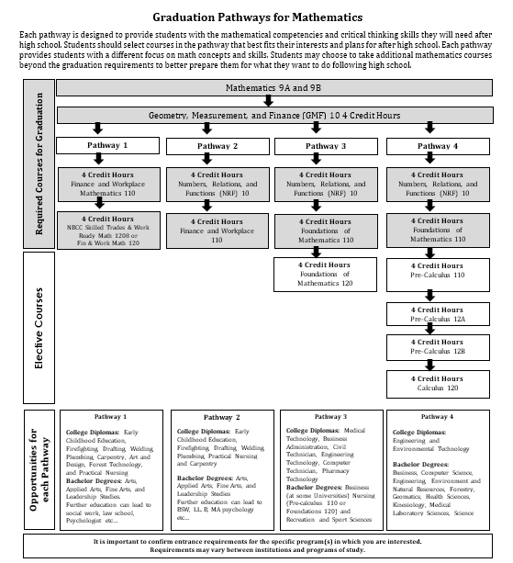
Math Pathways and Post Secondary Plans

Slide 10
Example of a Student’s course selections

Slide 11
Special Programs
Co-Op 120 (8 or 12 credit hour options)
Long Term Care Coop 120 (am only)
Early Childhood Coop 120
Personal Interest 1 & 2 (Grade 12)
Fine Arts Certificate
French Immersion Program
Certificate of Immersion - 5 FI courses in 11 & 12: Be Careful in selecting!
Certificate of Proficiency – must be in a grade 12 FI course to be tested
Dual Credit university courses (in Grade 12)
Lifeguarding Enrichment Program @NMS
Technical/Vocational Courses at FHS
Semester 1 – Welding/Metals Fabrication 110 and
Metals Processing 110
Semester 2 – Internal Combustion Engines 110 and
Tune Up and Emissions 120
Applications available at Guidance and due March 21st

Slide 12
REMINDER
Graduation Requirements are not the same as Post-Secondary Admission Requirements-
Students must do some research

Slide 13
Choosing Courses
Students must choose courses carefully.
Courses chosen by students determine courses offered next year.
If they choose a course, they will be expected to remain in the course.
Once schedules have been created, course changes are not entertained.
Course planning sheets are due to their Advisory teacher on March 14^{th.}
March 17th to 21st students need to be in Advisory to submit their course requests in the computer.

Slide 14
Questions?

