Slide 1

Entering Grade 10​
Parent Information Session
March 2024

Slide 2

Required Courses and Credits
In grade 10, students will begin earning credit hours toward graduation requirements.
Each course passed counts as 4 credit hours.
In grade 10, 11 and 12 students can earn up to 120 credit hours (10 courses/year = 40 credit hours).
Students must earn a min of 100 credit hours to graduate.
Most of their grade 10 courses are required but there is some choice.

Slide 3
Students entering grade 10 must take the following courses:
English Language Arts 10 Foundational 10
**English Language Arts 10 Extended 10 Geometry, Measurement & Finance (GMF) 10 (ENG or FI) Civics 10 (ENG or FI) **Science 10 (ENG or FI) Post Intensive French 10 OR FI Language Arts 10 OR Wolastoqey 10 **These courses are strongly recommended for all. See school counsellor for exceptions **

Slide 4
Students Must Choose Four of the following courses:
Biology 111/112
Computer Assisted Manufacturing 110
Creative Arts 110
Dance 110
Dramatic Arts 110
Entrepreneurship 110
Environmental Geoscience 110
Fashion Technology & Design 110
FI Numbers, Relations and Functions 10
FI/FSL Biology 112
FILA 110 (grade 3 or 6 entry)
FSL Tech de Com 110
Hockey Class/wellness 110 (application required)
Housing & Interior Design 120
Hospitality & Tourism 110
Human Physiology 110
Human Services 110
Indigenous Wabanaki Art 110
Intro to Debate 110
Intro to Skilled Trades 110
Introduction to Wolastoqey 110
Music 10 – Guitar, Keyboard, or Instrumental
Numbers, Relations & Functions Math 10
Physical Education 10
Post Intensive French 110
Psychology 110
Visual Arts 10
Visual Arts 110
Wellness 110
Writing 110
Yoga 110

Slide 5
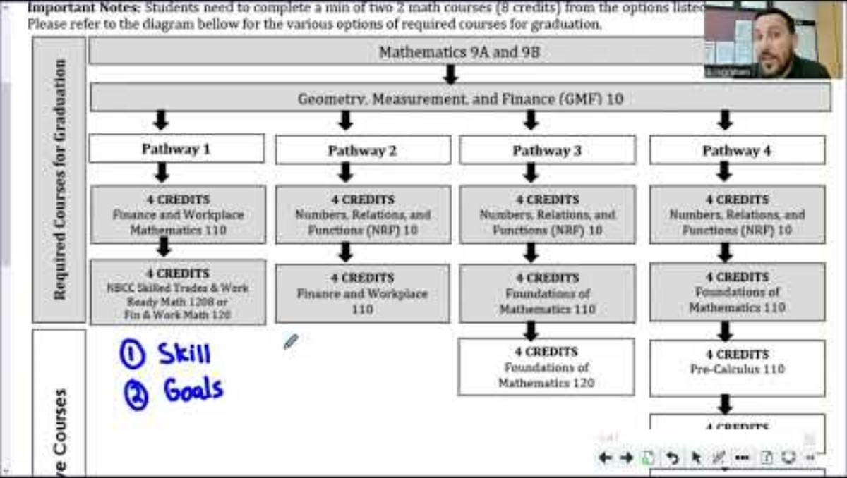

Slide 7
Choosing Electives
Consider completing core cluster options
Courses chosen by students determine what courses are offered next year.
If you choose a course, you will be expected to remain in the course.
Consider student’s interests and the courses they may wish to take in Grades 11 & 12.

Slide 8
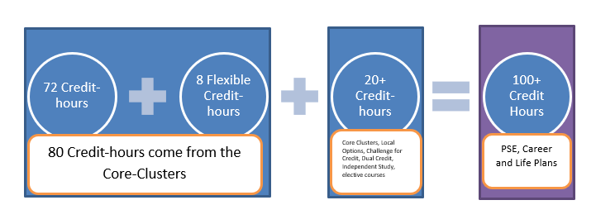
5 Core Clusters:
Language & Literacy - 24 CH
Humanities ​ - 8 CH
Mathematics - 12 CH
Science ​ - 8 CH
Personalized Well Being – 20 CH
Plus an additional 28 CH

Slide 9
Challenge for Credit – Fast Track
Successful completion of: | Is a “Pass” Credit Equivalent of:
Imagine NB | Personal Interest Course 1 and 2 (E or FI)
Scout Exploration Activity Award | Outdoor Education 110
Duke of Edinburgh Award – Young Canadians Challenge | Outdoor Education 110
Level 4 Cadet Training (in Air, Army, or Sea) | Outdoor Education 110
101/Fundamentals Level Coaching Certification (Competition or Instruction Stream) | Leadership Through Physical Education 120
National Lifesaving Society Certification (NLS) | Leadership Through Physical Education 120
Swim or Lifesaving Instructor Certification | Leadership Through Physical Education 120
Junior Achievement ‘Company Program’ Certificate | Entrepreneurship 110
The immersion program of Université Sainte-Anne | Techniques de communication orale
Girl Guides of Canada Trail Blazer Gold Award | Personal Interest Course 1 OR 2
See page 3 of the course guide for a complete list of fast-track credits.

Slide 10
Enter Two Alternate Courses
Students must carefully consider and choose 2 additional courses that they would take if any of their chosen courses cannot be scheduled.
- CANNOT select Biology 111 or Intro to Skilled Trades as alternate courses.

Slide 11
Course Selection Process
Talk
We encourage students to talk to their parents/teachers to help guide their decisions
Make
Make sure they select choices carefully. They will not have the opportunity to change their mind in the fall, unless it affects post secondary plans
Pass in
Pass in their completed Course selection form to their homeroom teacher by March 28th.
Be
Be in their Homeroom on April 2nd to 5th to enter their choices in the computer – if they are late, they may not get the courses you want

Slide 12
Questions?

