Slide 1
Entering Grade 11​
Parent Information Session
March 2024

Slide 2
Graduation Requirements
Required Courses:
English 10 Foundational
GMF or FI GMF
Must have a minimum of 100 credit hours.
ELPA must be passed; re-writes in gr. 11
English 10 Extended *
PIF 10 or FILA 10 or Wolastoqey 10
English 11 Foundational
English 12
Civics or FI Civics
Complete the required number of credit hours in each core cluster
Students wishing to obtain their French Immersion certificate require 40 Credit Hours in French in grades 10 - 12 ***

Slide 3
Course Levels
Grade
English
11
2
Level
Level "0" courses offered at one level only.
Ex: Entrepreneurship 110, Law 120, Sociology 120
Level "1" courses enriched university preparatory courses.
English 111, Physics 111
Level "2" courses academic/university preparatory.
Ex; English 112, Biology 112,
Level "3" – courses college preparatory/private training institutions such as NBCC, Majestany, Eastern College etc.
English 113, History 113 etc.

Slide 4
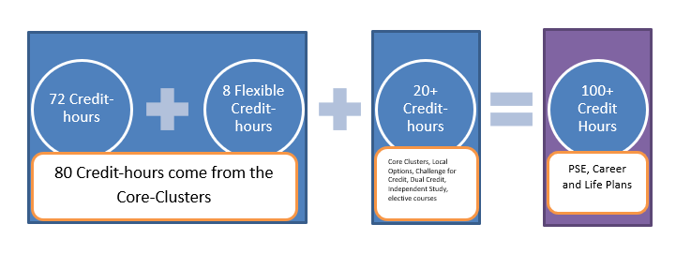
5 Core Clusters:
Language & Literacy - 24 CH
Humanities ​ - 8 CH
Mathematics - 12 CH
Science ​ - 8 CH
Personalized Well Being – 20 CH
Plus an additional 28 CH

Slide 5
Challenge for Credit – Fast Track
Successful completion of: | Is a “Pass” Credit Equivalent of:
Imagine NB | Personal Interest Course 1 and 2 (E or FI)
Scout Exploration Activity Award | Outdoor Education 110
Duke of Edinburgh Award – Young Canadians Challenge | Outdoor Education 110
Level 4 Cadet Training (in Air, Army, or Sea) | Outdoor Education 110
101/Fundamentals Level Coaching Certification (Competition or Instruction Stream) | Leadership Through Physical Education 120
National Lifesaving Society Certification (NLS) | Leadership Through Physical Education 120
Swim or Lifesaving Instructor Certification | Leadership Through Physical Education 120
Junior Achievement ‘Company Program’ Certificate | Entrepreneurship 110
The immersion program of Université Sainte-Anne | Techniques de communication orale
Girl Guides of Canada Trail Blazer Gold Award | Personal Interest Course 1 OR 2
See page 3 of the course guide for a complete list of fast-track credits.

Slide 6
Math Pathways and Post Secondary Plans

Slide 7
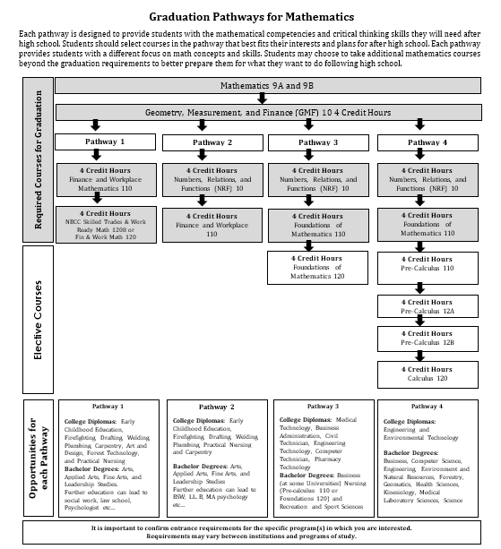
Math Pathways and Post Secondary Plans

Slide 8
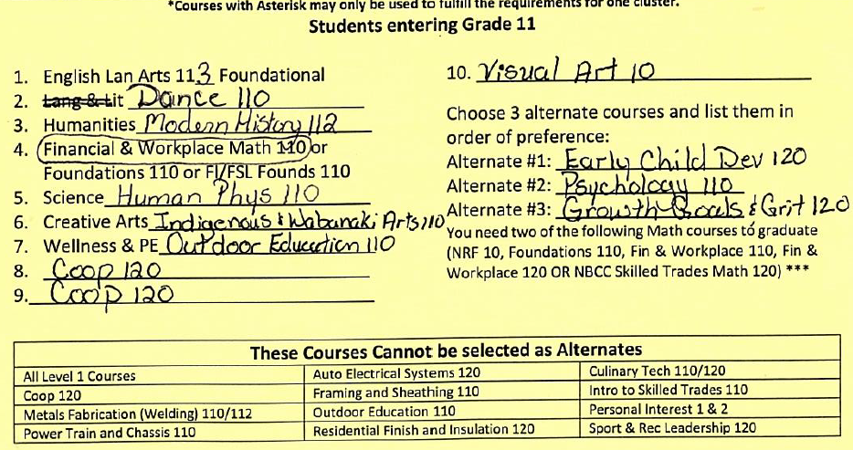
Example of a Student’s course selections

Slide 9
Special Programs
Co-Op 120 (8 or 12 credit hour options)
Long Term Care Coop 120 (am only)
Early Childhood Coop 120
Personal Interest 1 & 2 (Grade 12)
Fine Arts Certificate
French Immersion Program
Certificate of Immersion - 5 FI courses in 11 & 12: Be Careful in selecting!
Certificate of Proficiency – must be in a grade 12 FI course to be tested
Dual Credit university courses (in Grade 12)
Lifeguarding Enrichment Program @NMS
Technical/Vocational Courses at FHS
Semester 1 – Framing and Sheathing 110 and
Residential Finish and Insulation
Semester 2 – Auto Electrical 120 and
Power Train and Chassis 110
Applications available at Guidance and due April 5th

Slide 10
REMINDER
Graduation Requirements are not the same as Post-Secondary Admission Requirements-
Students must do some research

Slide 11
Choosing Courses
Students must choose courses carefully.
Courses chosen by students determine courses offered next year.
If they choose a course, they will be expected to remain in the course.
Once schedules have been created, course changes are not entertained.
Course planning sheets are due to their homeroom teacher on March 28^{th.}
April 2rd to 5th students need to be in homeroom to submit their course requests in the computer.

Slide 12
Questions?

